Slide 1


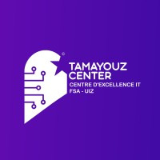

A Microservices-Based Distributed Coffee Management System
DEVELOPMENT TEAM
FATIMA IBOUBKARNE
SALMA JEGHLOUL
AMINA FARIS
AYOUB EL ORF
ABDELKBIR CHOUITER
ISMAIL DAKIR

Slide 2


Presentation Plan
Introduction & Context
Distributed System Concepts
System Architecture
Technologies Used
Tests & Validation
System Workflow
Business Impact
Demo
Conclusion

Slide 3


Introduction & Context
As a business owner managing multiple coffee shop branches, it becomes essential to efficiently handle orders, inventory, and administration across different locations. Traditional monolithic applications are often not flexible or scalable enough to support this growth. This need led to the development of a microservices-based distributed coffee management system, designed to provide scalability, reliability, and efficient management through independent distributed services.

Slide 4
Distributed System Concepts
What is a Distributed System
How My Project Qualifies as a Distributed System
Multiple independent services
Network communication via REST and gRPC
Each service runs in its own Docker container → isolated and independent
Shared database: each service handles specific responsibilities
Services work together to manage coffee shop operations
A system with multiple independent components
Components communicate over a network
Components work together as a single system
Provides scalability, fault tolerance, and flexibility

Slide 5
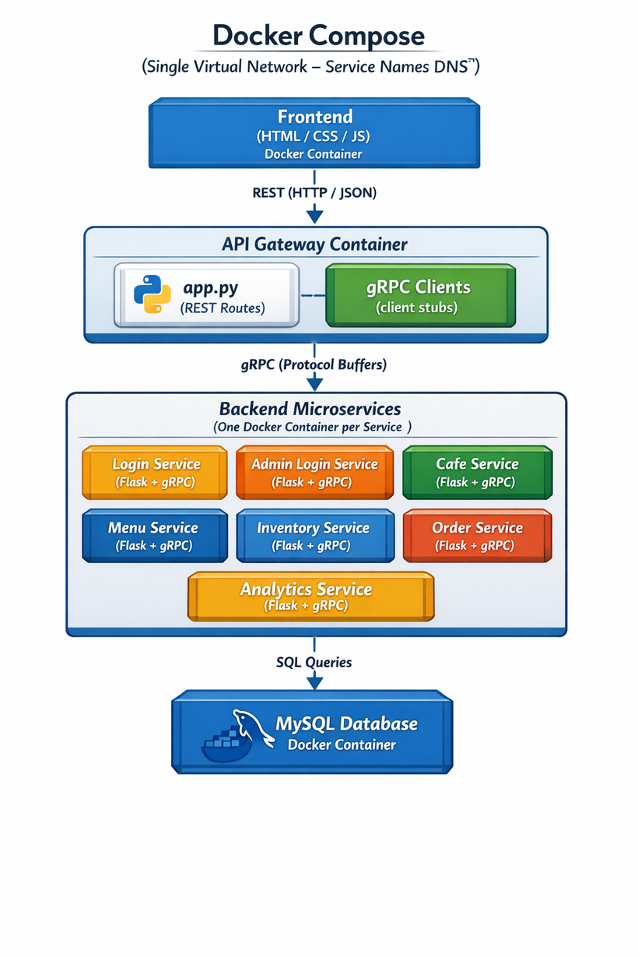
System Architecture

Slide 6

Technologies Used
Programming & Development
Communication & Distributed Tools
Deployment, Data & Testing
Docker (containerization)
SQL
pytest (unit and integration testing)
scikit-learn (ML library for sales prediction & analytics)
Python (backend logic)
Flask (REST API framework)
HTML / CSS / JavaScript (frontend interface)
REST (client-service communication)
gRPC (service-to-service communication)

Slide 7
Tests & Validation
Unit Tests: Each service tested independently using pytest
Integration Tests: Verified communication between services (REST & gRPC)
Performance Checks: Ensured services respond correctly under multiple requests
Data Validation: Verified database updates and analytics calculations
Result: System behaves reliably and produces accurate analytics & predictions

Slide 8
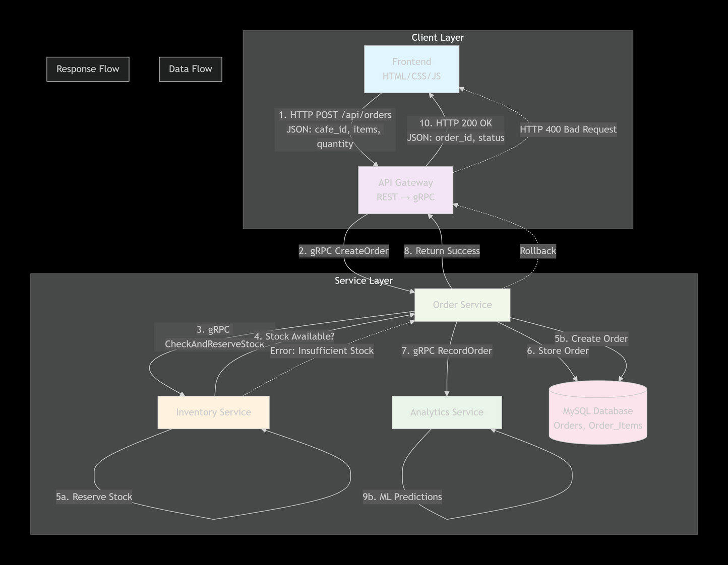
System Workflow
Use Case example : placing an order

Slide 9
Explanation
Client submits order → REST → API Gateway
API Gateway → gRPC → Order Service validates order
gRPC → Inventory Service checks & updates stock
Order stored → SQL database (Orders & Order_Items)
gRPC → Analytics Service updates sales & ML predictions
Confirmation sent → Client sees success message

Slide 10


Business Impact
Efficient Multi-Branch Management: Manage multiple cafés from a single platform
Data-Driven Decisions: Analytics & ML predictions help identify trends and top-performing items
Inventory Optimization: Stock is automatically tracked and updated, reducing waste
Improved Customer Service: Faster order processing and accurate availability info
Scalable & Reliable: Microservices architecture allows independent scaling of services

Slide 11
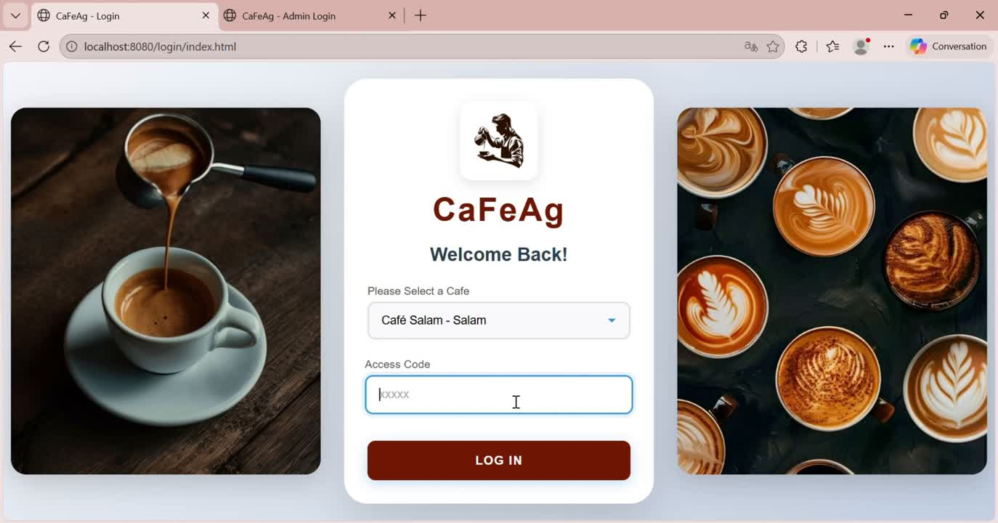
Demo

Slide 12
Conclusion
In conclusion, our Coffee Management System demonstrates the power of distributed systems in real-world business applications. Using a microservices architecture, REST and gRPC communication, and automated analytics with ML predictions, café owners can manage multiple branches efficiently. Inventory, orders, and analytics work together seamlessly, providing real-time insights and improving decision-making. The system is scalable, reliable, and ready to grow with the business.

